Slide 1
Machine Learning ePDG@CMInDS
Instructors: Sharayu Moharir & Jayakrishnan Nair
sharayum@ee.iitb.ac.in, jayakrishnan.nair@ee.iitb.ac.in
Lectures:
Monday (7.30 – 9.00 pm)
Saturday (9.30 – 11.00 am)
TA session: Saturdays (2.30 – 3.30 pm)

Slide 2
Basic definitions
Artificial intelligence:
Ability of computer systems and machines to perform tasks that conventionally require human intelligence.
Machine Learning:
Subset of AI that seeks to design systems that can learn from data to perform tasks without explicit programming.

Slide 3
Basic definitions
Artificial intelligence:
Ability of computer systems and machines to perform tasks that conventionally require human intelligence.
Machine Learning:
Subset of AI that seeks to design systems that can learn from data to perform tasks without explicit programming.

Slide 4
Basic requirement for ML: pattern that can be learned from data
“In God we trust. All others must bring data.”
W. Edward Demmings
Q: When does ML make sense?
There is a pattern to be learnt from data
The pattern is hard to define (and program explicitly)
E.g.: clean governing equations/laws unavailable
There is enough data about the pattern

Slide 5

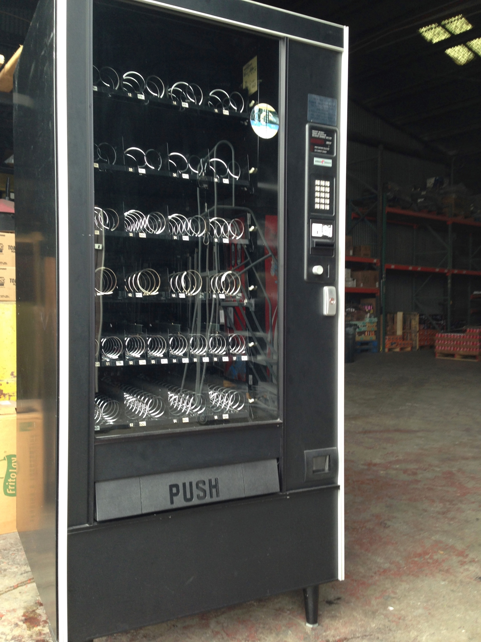
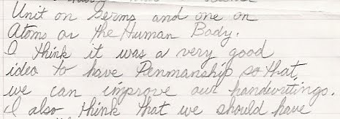
Which of the following scenarios is/are ML-amenable?
When will my baby cry
next?
Identify coins inserted
into vending machine
Convert handwriting to digital text

Slide 6
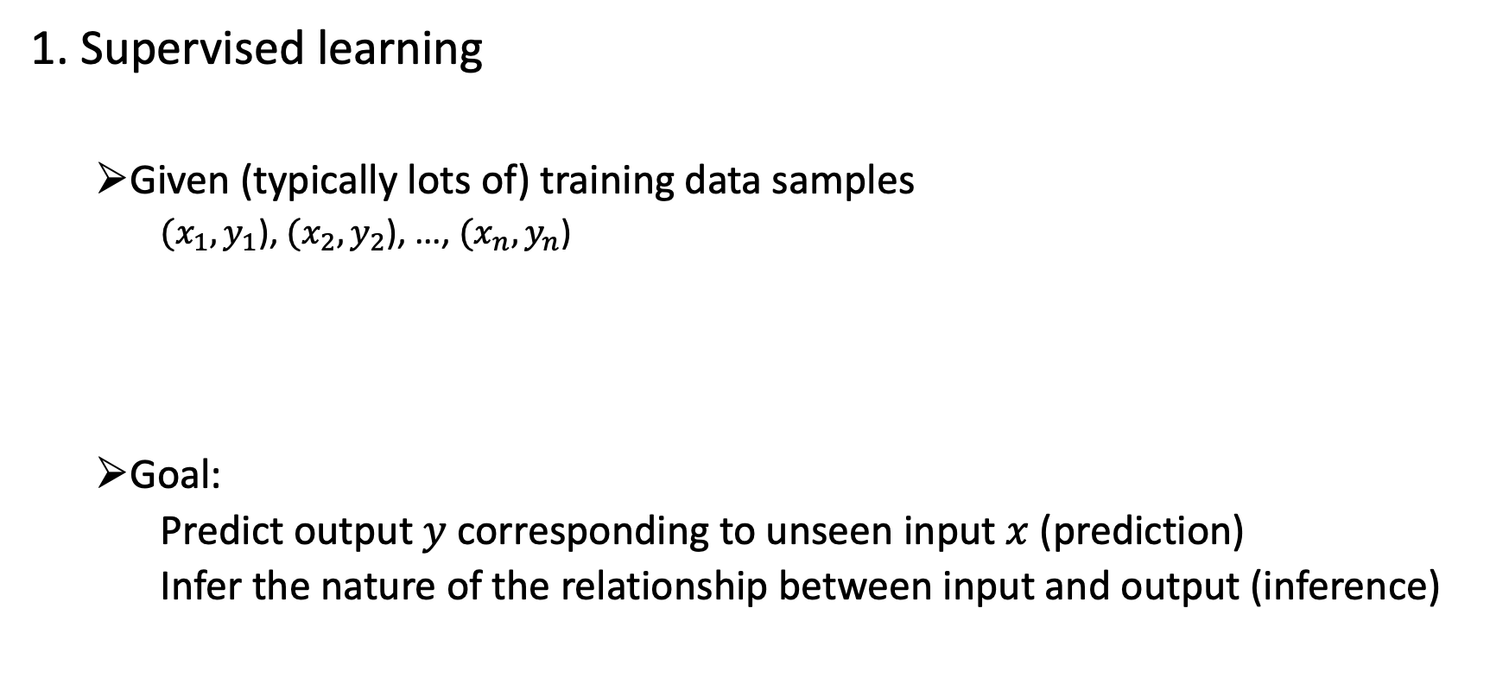
Three kinds of ML
1. Supervised learning
Given (typically lots of) training data samples
$(x_{1},y_{1}$), $(x_{2},y_{2}$), ..., $(x_{n},y_{n}$)
Goal:
Predict output $y$ corresponding to unseen input $x$ (prediction)
Infer the nature of the relationship between input and output (inference)
input
output
most of this course

Slide 7
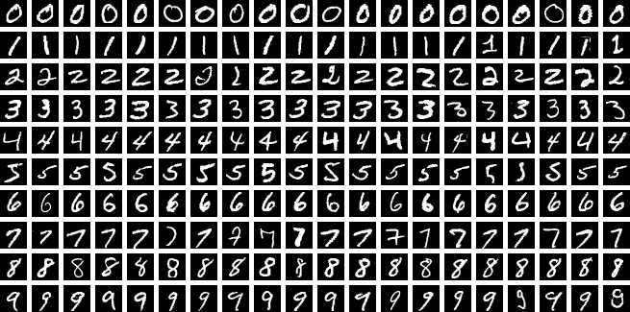

Example: handwritten digit recognition
$x$: an image of the form
$y$: number in image
(MNIST dataset)

Slide 8

Example: product marketing
$x$: (TV ad spend, radio ad spend, online ad spend)
$y$: sales

Slide 9

Example: loan processing
$x$: (age, salary, credit history)
Case 1: $y$: loan interest rate
Case 2: $y$: accept/reject loan application

Slide 10








An example we are all familiar with...
$x$: (incomplete) string of text
$y$: next word in the string

Slide 11
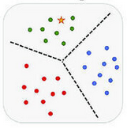

Three kinds of ML
2. Unsupervised learning
Given (typically lots of) data samples of the form
$$x_{1},x_{2}, .…, x_{n}$$
Goal:
Find patterns in the data
Eg: Clustering
no “output”
some coverage in this course

Slide 12
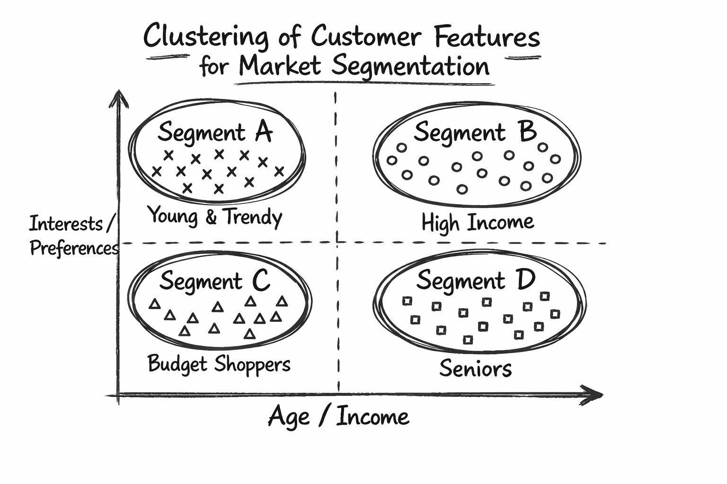

Example: market segmentation
$x=$(age, gender, pin code, spend history,....)
Goal: Segment customers into clusters (for marketing / product dev.)

Slide 13
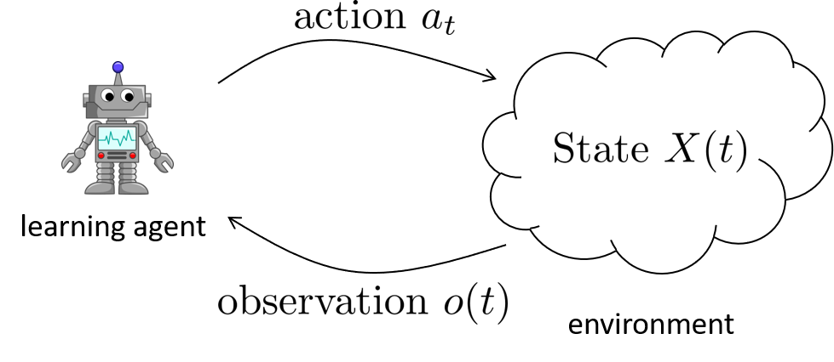
Three kinds of ML
3. Reinforcement Learning
Learning in scenarios where a learning agent (a.k.a., algorithm) interacts with an (apriori) unknown environment sequentially
Env. state evolves based on
current state and current action
Reward also depends on
current state and action
Present action influences future
rewards
Q: How to optimally interact with
the environment?

Slide 14
Three kinds of ML
3. Reinforcement Learning
Learning in scenarios where a learning agent (a.k.a., algorithm) interacts with an (apriori) unknown environment sequentially
Examples:
Autonomous driving
Robotic manipulation
Chess bots
no coverage in this course

Slide 15
Three kinds of ML (summary)
1. Supervised Learning (most of this course)
2. Unsupervised learning (some of this course)
3. Reinforcement Learning (no coverage here – electives later)

Slide 16
Course content
Linear regression
Model selection & Regularization
Cross-validation & Bootstrap
Support vector machines
Kernel methods
Tree-based methods
Deep neural networks
Classification
Principal components analysis
supervised learning
unsupervised learning

Slide 17
Detailed course plan (first half)
* tentative
Lecture # | Date | Material covered
1 | 02/02/26 | Introduction to AI & ML Supervised vs Unsupervised vs Reinforcement Learning
2 | 07/02/26 | Background in convexity, optimization & linear algebra
3 | 09/02/26 | Linear regression -- ordinary least squares optimization, case studies
4 | 14/02/26 | Probability background
5 | 16/02/26 | Statistical framework, hypothesis testing, goodness of fit
6 | 21/02/26 | Model assessment & selection: subset selection, cross-validation
7 | 23/02/26 | Model assessment & selection: bootstrapping, in-sample methods
8 | 28/02/26 | Gradient descent
9 | 07/03/26 | Introduction to convex optimization: Primal, dual, KKT conditions
10 | 09/03/26 | Introduction to classification -- Perceptron Learning Algorithm (PLA)
11 | 14/03/26 | Hard margin classifier, support vector machine (SVM)
12 | 16/03/26 | Kernel functions & kernel SVM

Slide 18
Detailed course plan (second half)
* tentative
Lecture # | Date | Material covered
13 | 30/03/26 | Shrinkage methods for regression: Ridge regression & LASSO
14 | 04/04/26 | Kernalizing Ridge regression, PLA
15 | 06/04/26 | Classification: Logistic regression
16 | 11/04/26 | Classification: Gaussian discriminant analysis
17 | 13/04/26 | Classification: Naive Bayes
18 | 18/04/26 | Decision trees
19 | 20/04/26 | Decision trees (continued)
20 | 25/04/26 | Bagging, Random forest
21 | 27/04/26 | Boosting
22 | 02/05/26 | Unsupervised learning, K-means clustering
23 | 04/05/26 | Principal component analysis
24 | 09/05/26 | Principal component analysis (continued)

Slide 19

Textbook
Legally available for free download:
https://www.statlearning.com

Slide 20
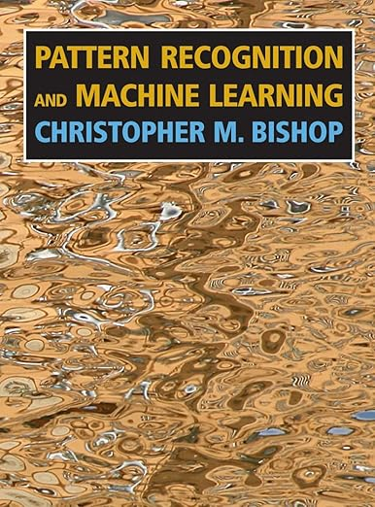
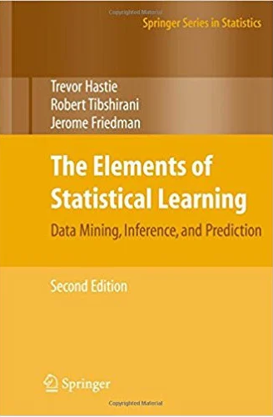
Additional reference s (also legally downloadable for free)
link
link

Slide 21
Evaluation
Quizzes (2) – 20% (one in each half of the semester)
Assignments – 20%
Mid-term exam – 20%
End-term exam – 40%

Slide 22
Course guidelines
Attendance policy: 80% minimum attendance mandatory
Attending lectures live is strongly encouraged
Expectation is that you spend 3 hours per week on this course (not counting live classes and tutorials)
Passing the course requires scoring > 40% on the end-semester exam
End-semester exam in person at IIT Bombay

Slide 23
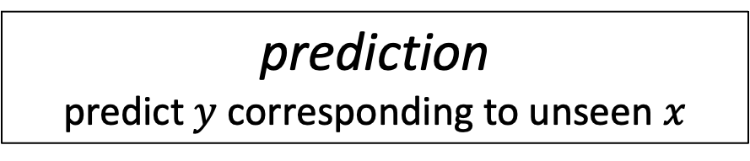
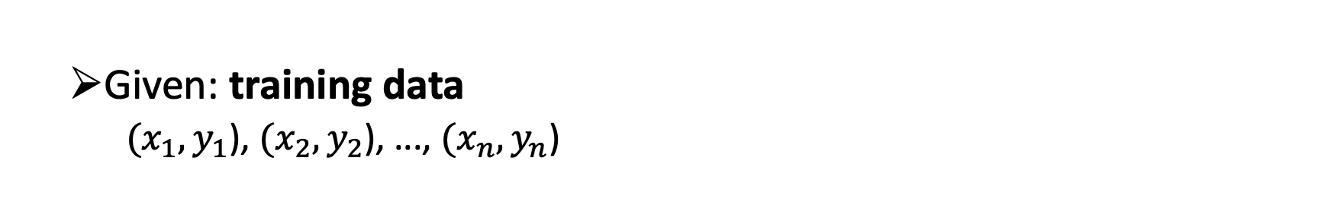
Back to supervised learning
prediction
predict $y$ corresponding to unseen $x$
Given: training data
$(x_{1},y_{1}$), $(x_{2},y_{2}$), ..., $(x_{n},y_{n}$)
inference
infer nature of the input-output relationship

Slide 24
Back to supervised learning
prediction
predict $y$ corresponding to unseen $x$
Given: training data
$(x_{1},y_{1}$), $(x_{2},y_{2}$), ..., $(x_{n},y_{n}$)
inference
infer nature of the input-output relationship
Ex: Does a certain input feature influence output?
Does gender influence loan default probability?

Slide 25
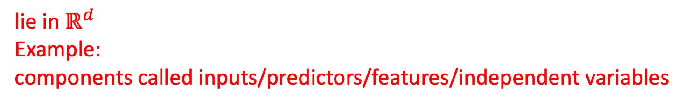
Back to supervised learning
Given: training data
$(x_{1},y_{1}$), $(x_{2},y_{2}$), ..., $(x_{n},y_{n}$)
lie in $ℝ^{d}$
Example:
components called inputs/predictors/features/independent variables
Q: What is the input in the MNIST digit recognition task?

Slide 26
Back to supervised learning
Given: training data
$(x_{1},y_{1}$), $(x_{2},y_{2}$), ..., $(x_{n},y_{n}$)
one-dimensional for now
called output/label/dependent variable

Slide 27
Back to supervised learning
Given: training data
$(x_{1},y_{1}$), $(x_{2},y_{2}$), ..., $(x_{n},y_{n}$)
Variables (input and output) can be of different types:
Quantitative (real valued)
Qualitative/categorical/discrete
(e.g.: 0/1, Cat/Dog/Monkey)

Slide 28
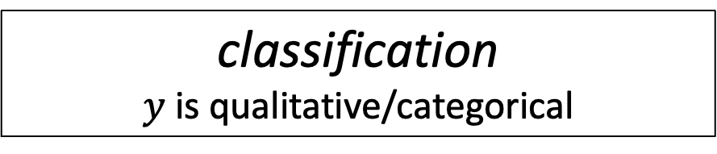

Prediction in supervised ML
regression
$y$ is quantitative
classification
$y$ is qualitative/categorical
Ex: loan processing with interest rate o/p
Ex: loan processing with binary o/p
Q: Category of the MNIST digit recognition task?

Slide 29
Prediction in supervised ML
regression
$y$ is quantitative
classification
$y$ is qualitative/categorical
Different techniques for regression and classification tasks
Will study both as part of this course

Slide 30
Machine Learning
Supervised learning
Unsupervised learning
Reinforcement learning
Prediction
Inference
Regression
Classification

Slide 31
Machine Learning
Supervised learning
Unsupervised learning
Reinforcement learning
Prediction
Inference
Regression
Classification
this course

Slide 32
next class
next class
* courtesy: Prof. Amit Sethi

Slide 33
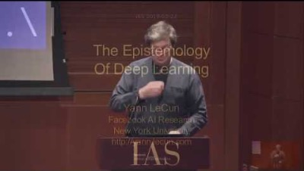
Some interesting videos
The Epistemology of Deep Learning - Yann LeCun

Slide 34
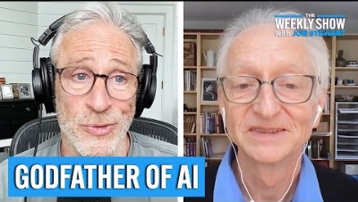
Some interesting videos
AI: What Could Go Wrong? with Geoffrey Hinton | The Weekly Show with Jon Stewart

Slide 35
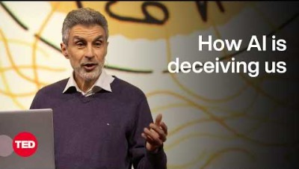
Some interesting videos
The Catastrophic Risks of AI — and a Safer Path | Yoshua Bengio | TED

